Slide 1
EvChargeIQ
Team Members :
S.NO | NAME | ROLL NUMBER
1 | B. Gnaneshwari | 2420030781
2 | M. Rithika Reddy | 2420030683
3 | S. Alekhya | 2420030603
Faculty Guide : Dr. N Sirisha

Slide 2
Overview
Comparisions

Slide 3
Comparision
 | Existing Model | Proposed Model
 | Forecasting-focused approach: Existing implementations mainly concentrate on predicting EV charging demand using models such as ConvLSTM, LSTM, Seq2Seq, and other deep-learning techniques. | End-to-end forecasting and optimization: EVChargeIQ combines demand forecasting with data ingestion, distributed processing, storage, pipeline orchestration, and charging-station utilization analysis.
 | Limited real-time integration: Several existing approaches primarily use historical charging data and identify real-time data integration as future work. | Real-time data pipeline: EVChargeIQ uses Apache Kafka for data ingestion and Apache Spark for distributed processing, providing a foundation for continuous EV charging-data processing.
 | Limited scalability focus: Existing studies mainly concentrate on improving forecasting accuracy, while scalability and real-time forecasting are identified as areas for future improvement. | Scalable data engineering architecture: EVChargeIQ uses Kafka + Spark + PostgreSQL + Airflow to build a scalable pipeline for collecting, processing, storing, and managing EV charging data.

Slide 4
Comparision
 | Existing Model | Proposed Model
 | Dependence on historical data: Existing approaches primarily rely on previously collected EV charging datasets, which may not fully reflect recent charging demand patterns. | Real-time data integration: EVChargeIQ uses Kafka-based data ingestion to support continuous collection of EV charging data alongside historical data analysis.
 | Limited geographical coverage: Some existing studies focus on individual charging stations or specific geographical regions, limiting broader analysis. | Multi-station analysis: EVChargeIQ analyzes charging-station demand and utilization to identify congested and underutilized stations across the available dataset.
 | Limited temporal analysis: Certain forecasting models focus on specific prediction intervals, making it difficult to support different demand-analysis requirements. | Flexible demand analysis: EVChargeIQ combines machine-learning-based demand forecasting with processed charging data to support demand-pattern and station-utilization analysis.

Slide 5
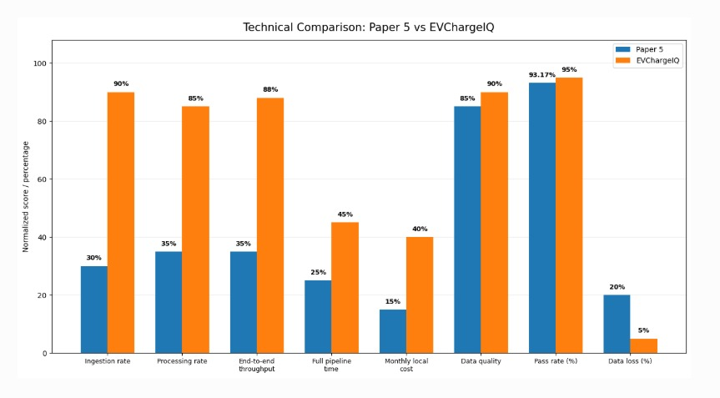

Slide 6
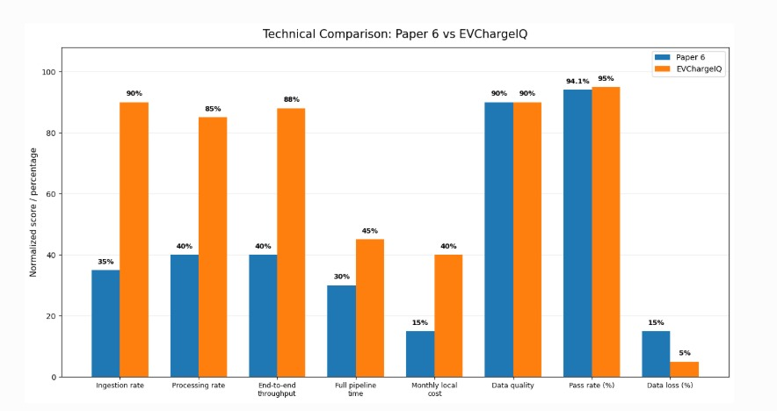

Slide 7
THANK YOU

